Slide 1
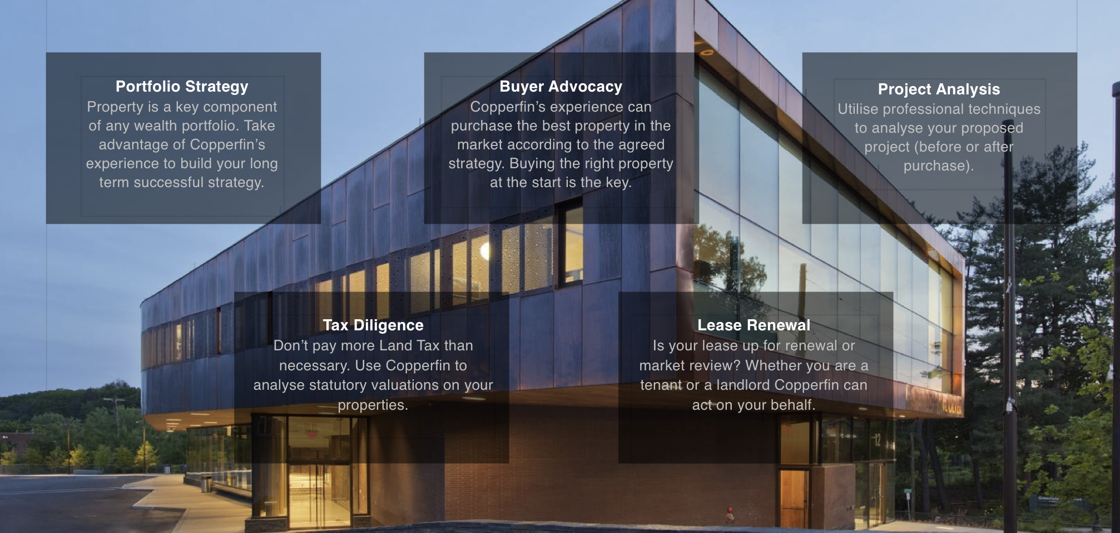
Who is Copperfin
Copperfin is a property advisory business that provides strategic advice to help its clients achieve an edge when it comes to property purchases, sale, management and development.

Slide 2
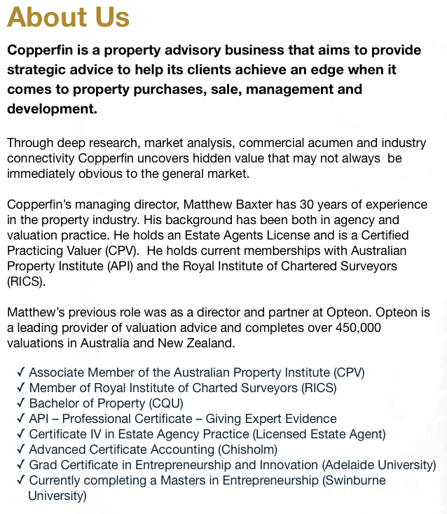

Slide 3
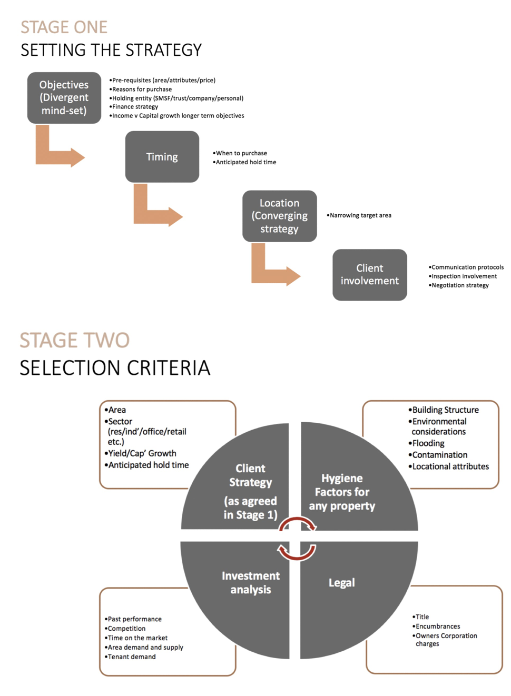
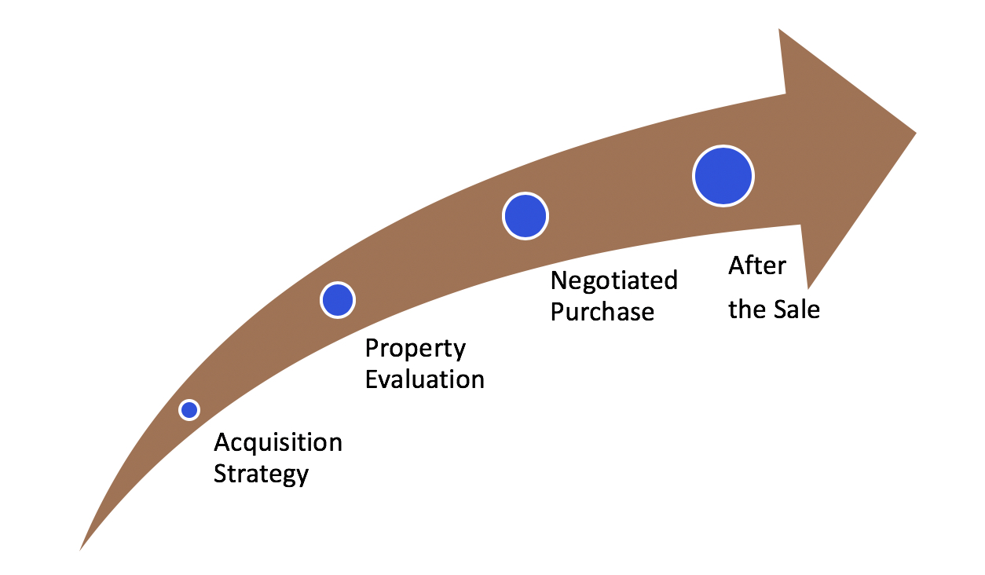
Buyer Advocacy

Slide 4
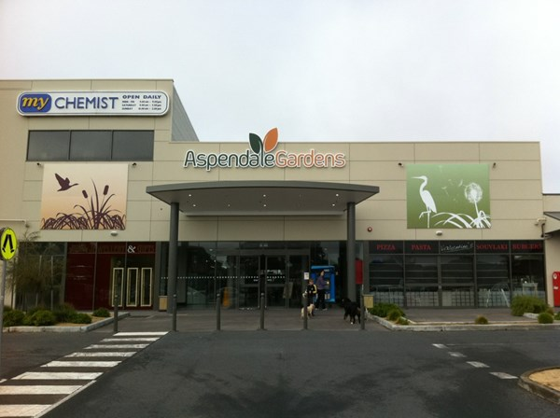
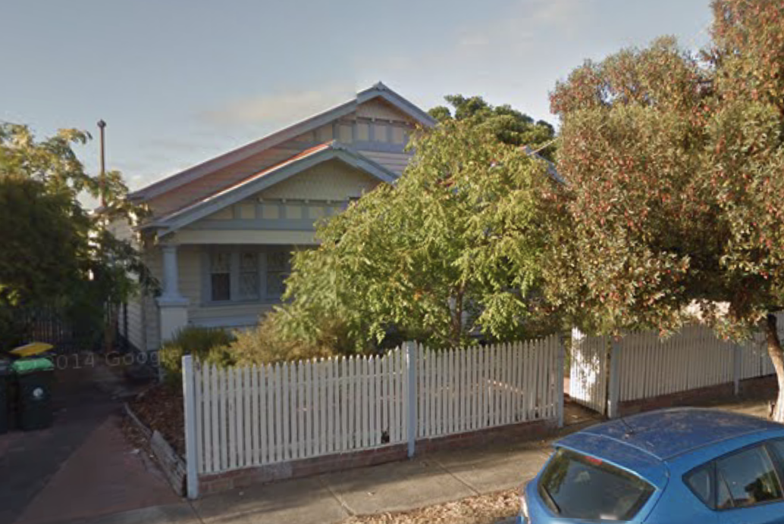
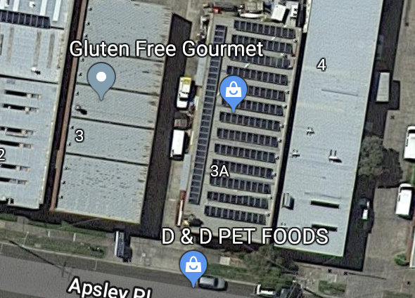
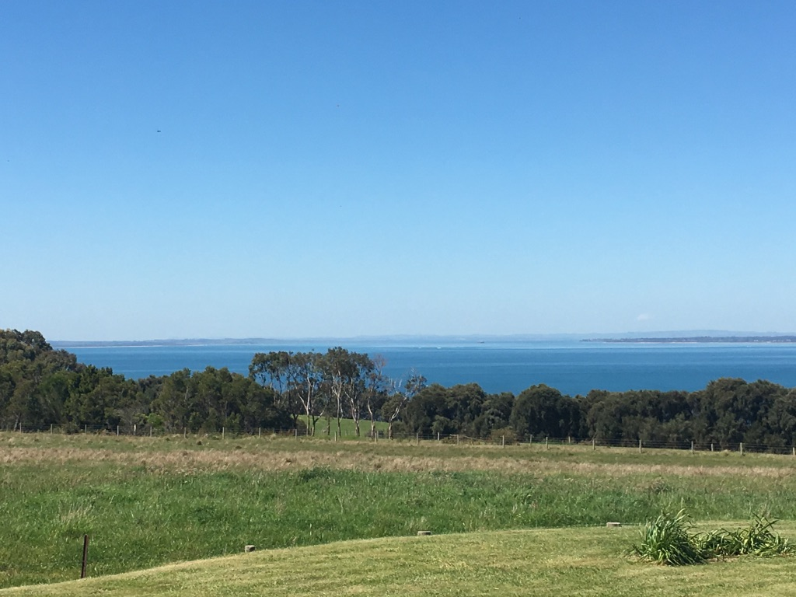
Properties we have
been involved in

Slide 5
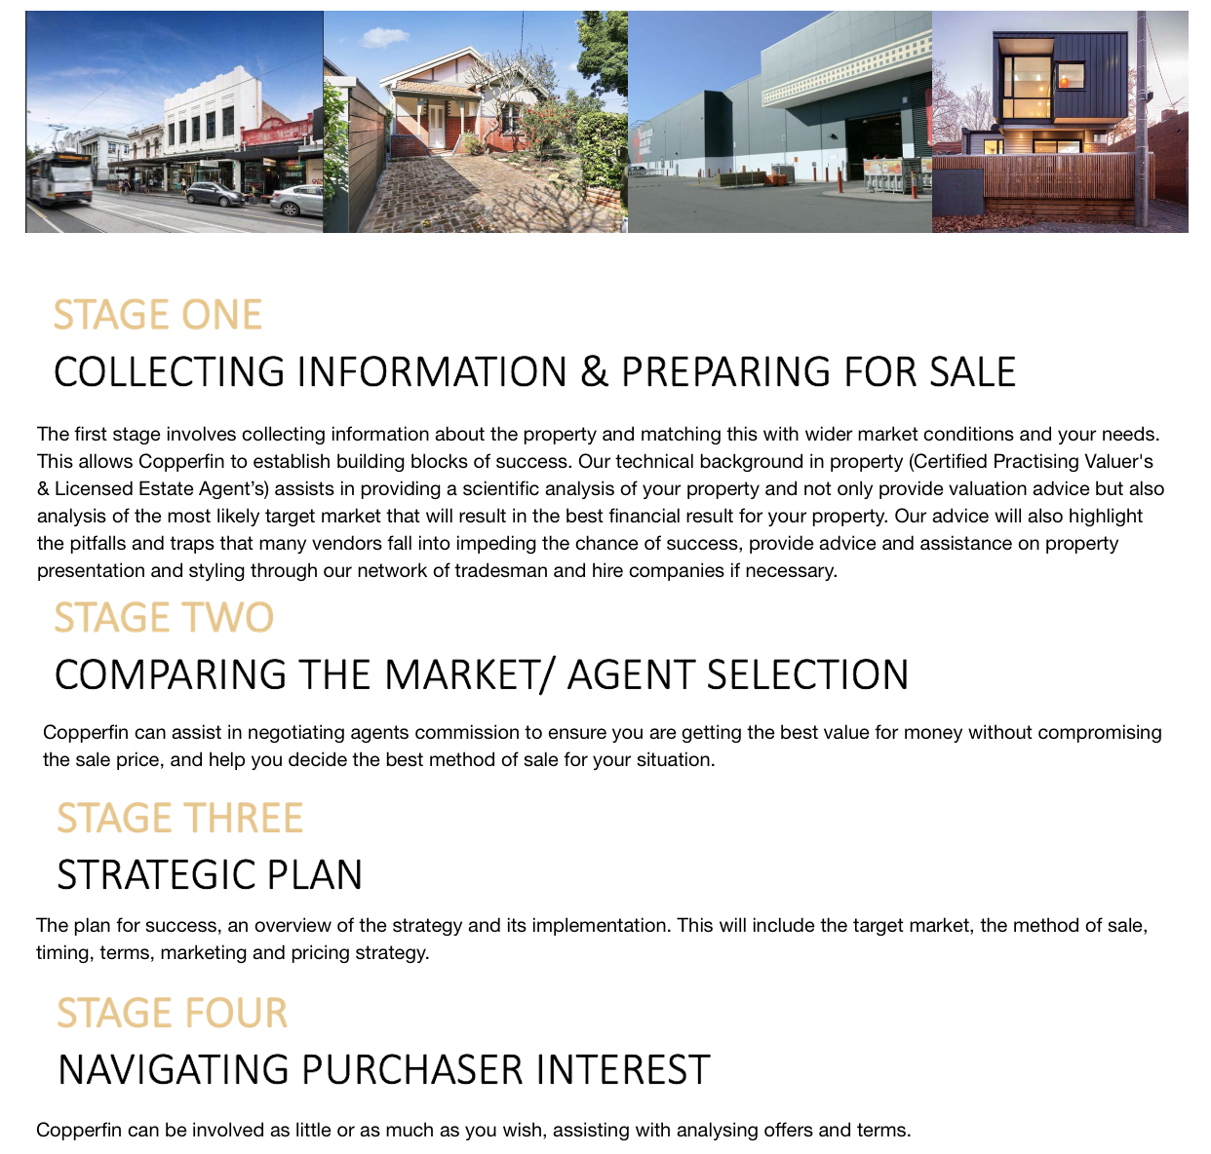
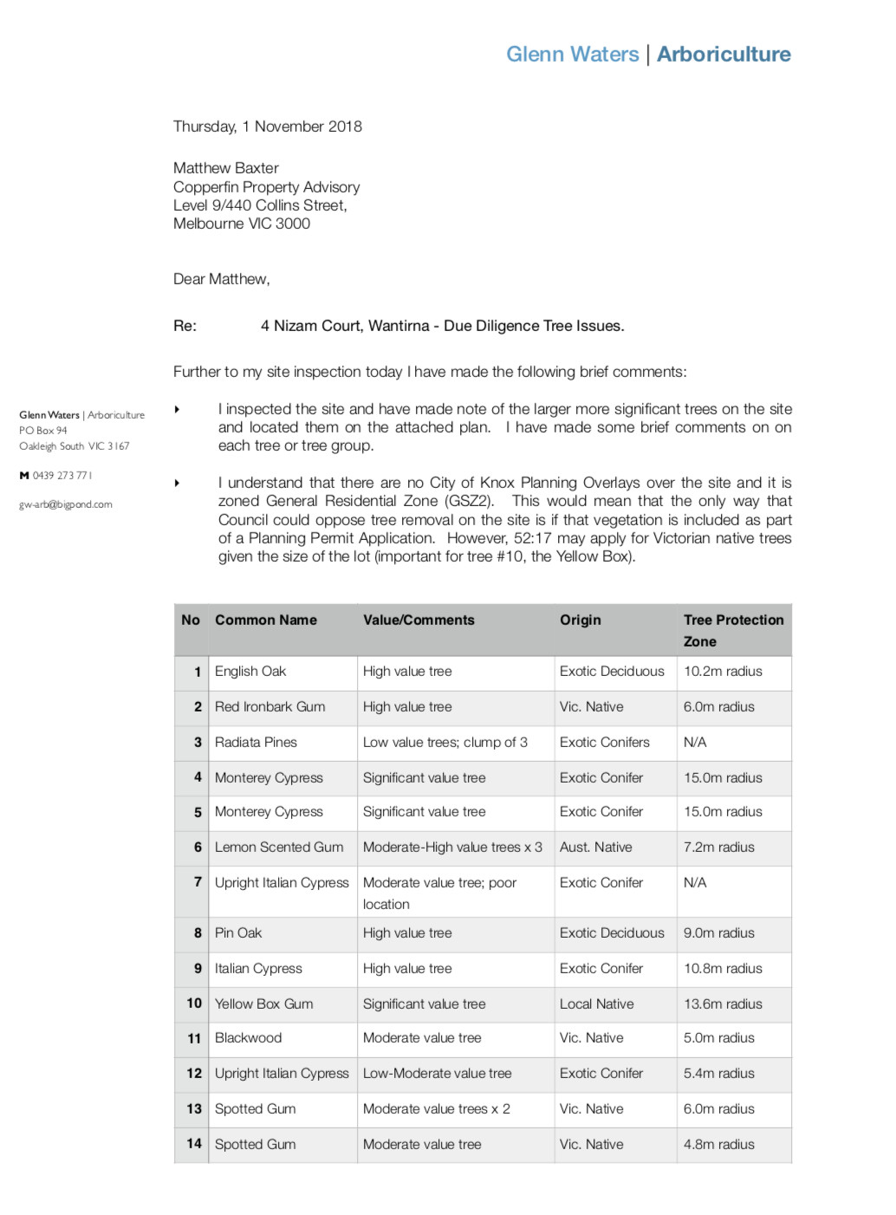
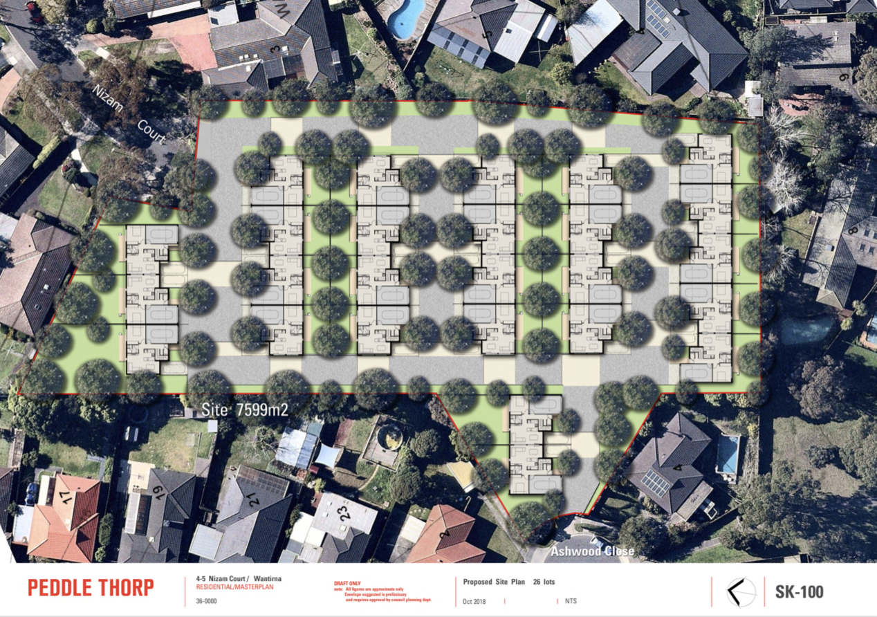
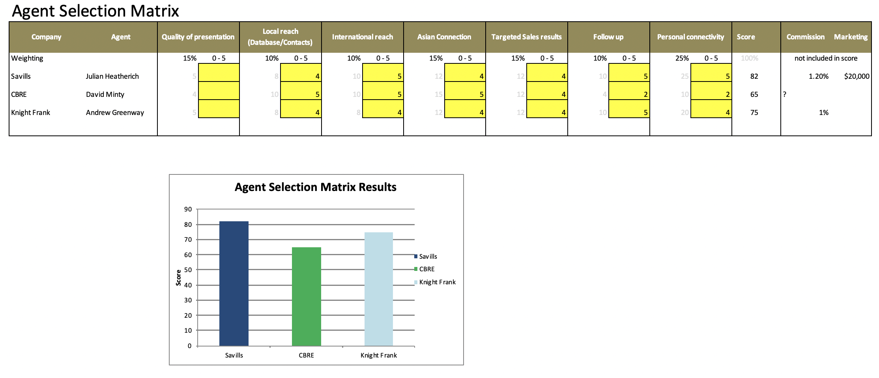
Transaction Advisory

Slide 6
Changing Cycle

Slide 7
Current Drivers
Tougher lending & Government intervention has slowed the market

Slide 8
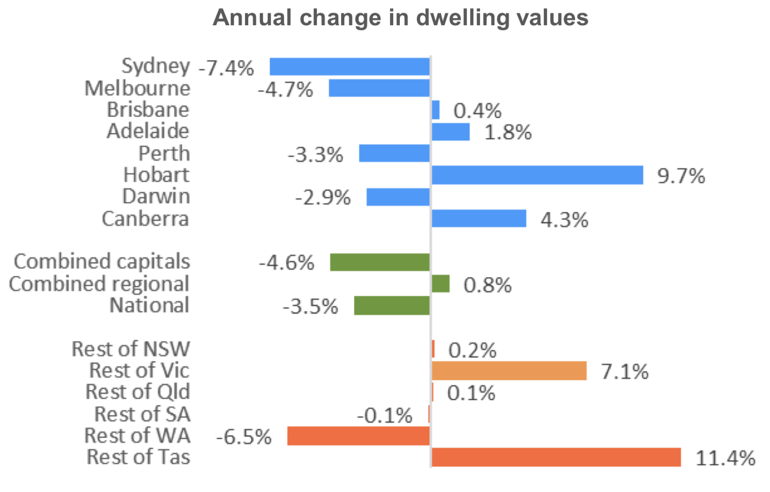
Changes in Melbourne Value
The real story is in Melbourne’s upper and lower quartile.

Slide 9
What would it take for house
prices to drop by 40%?
Demand
Availability of finance
Borrowing costs (affordability)
Employment
Supply to the market
Government Policy (Negative Gearing/Land Tax/Stamp duty
Supply

Slide 10
Auction clearance & supply

Slide 11
Unemployment/Employment

Slide 12
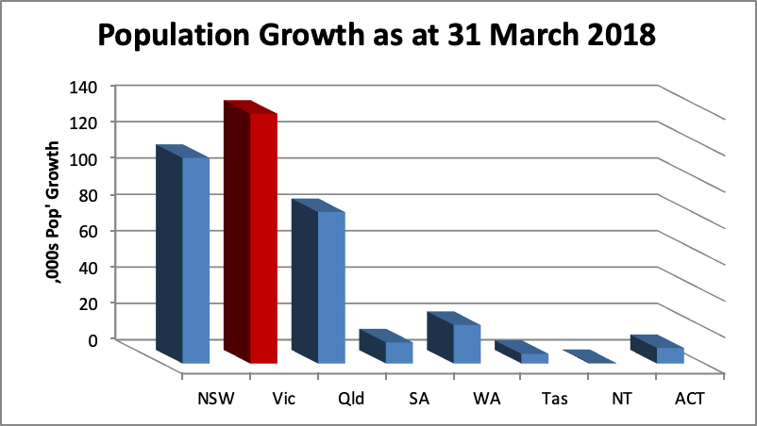
Population Growth

Slide 13
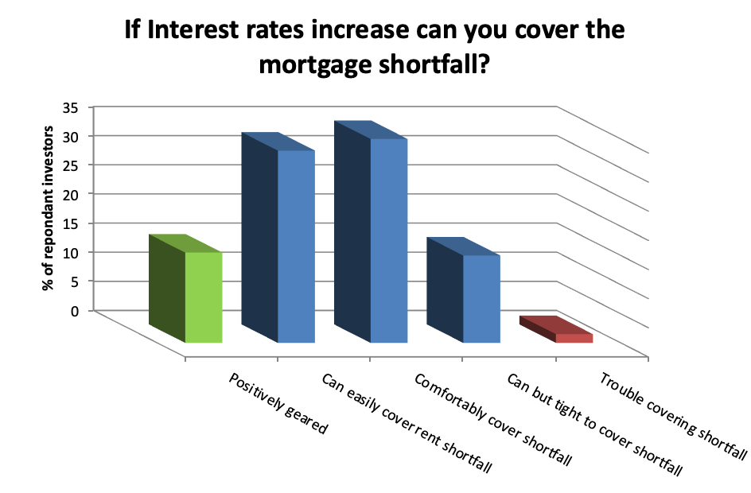
Investor Affordability Survey

Slide 14
ADI Loan Book

Slide 15
Risks to Market
Interest rates (RBA & SVR)
Unemployment
Economy (GDP growth rate)
Household debt to GDP
Population growth
Unpredictable event

Slide 16
Thank You
External Sources
APRA
ABS
RBA
REIV
CoreLogic
PIPA
Trading Economics

